Slide 1
CMGT400
Intro to Information Assurance and Security
(University of Phoenix)
Lecture, Week 4
Tom Olzak, MBA, CISSP

Slide 2
Security Program
Policy
  Issue
  System
  Enterprise
Standards
Guidelines
Procedures
Training and awareness
Notes:
Enterprise information security program policy, which sets the strategic direction, scope, and tone for all security efforts; the EISP must be based on and must support the organization’s vision and mission statement
Issue-specific information security policies, which provide guidance to all members of an organization regarding the use of information technology
System-specific information security policies, which guide the management and technical specifications of particular technologies and systems

Slide 3
Policy Overview
Statement of the organization’s position, intended to influence employee behavior and information, network, security, and application architecture design
Specifies outcomes expected by management
  Regulations
  Stakeholder and customer expectations
  Ethics
Specifies what, not how
Developed by representatives from all affected groups
Approved and supported by management

Slide 4
Policy Content
Statement of management’s position relative to the system, issue, or mission-based outcomes expected or required
List of those responsible for managing the policy and its enforcement
Sanctions for not complying with the policy

Slide 5
Measuring Policy Outcomes
Define what is to be measured and expected results using the following criteria
  Determine the effectiveness of the execution of information security policy
  Determine the effectiveness and/or efficiency of the delivery of information security services
  Assess the impact of an incident or other security event on the organization or its mission.
Methods
  Penetration tests
  Response testing and root cause analysis
  Audits

Slide 6
Metrics
Difficult to measure what we are trying to prevent
Compliance and certification is not necessarily security
  Regulations
  Standards of best practice
  Internal standards and guidelines
Best test is looking at the network from an attacker’s perspective and auditing overall outcomes

Slide 7
Penetration Tests
“A penetration test is a proactive and authorized attempt to evaluate the security of an IT infrastructure by safely attempting to exploit system vulnerabilities, including OS, service and application flaws, improper configurations, and even risk behavior. Such assessments are also useful in validating the efficacy of defensive mechanisms, as well as end-user’s adherence to security policies.”
(http://www.coresecurity.com/content/what-is-pen-test)

Slide 8
Audits
Measure outcomes to ensure compliance with policies
Do not confuse with risk assessments
Two types:
  Internal
  External

Slide 9
Employee Risk
Employees are the largest attack surface
Employee vulnerability examples
  Social engineering
    Phishing
    Spear phishing
    Masquerading
  Fueling dumpster diving
Carelessness
Ignorance of policies
Revenge or social activism

Slide 10
Training & Awareness
Training
  The purpose of security and why it is important, including how it affects each employee personally
  Their role in security
  Policies, standards, and guidelines
Awareness
  Continuous campaign
    Posters
    Newsletters
Audiences
  Employees
  Managers
  IT

Slide 11
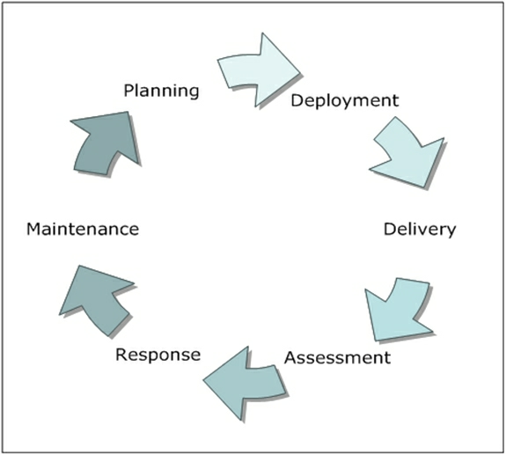
Training/Awareness Process
http://www.microsoft.com/security/resources/default.aspx#Free-materials

Slide 12
And again…
Be sure to read ALL assigned reading. Your success in this class depends on it.

